Slide 1


Financial Accounting
Financial Accounting
Introduction

Slide 2
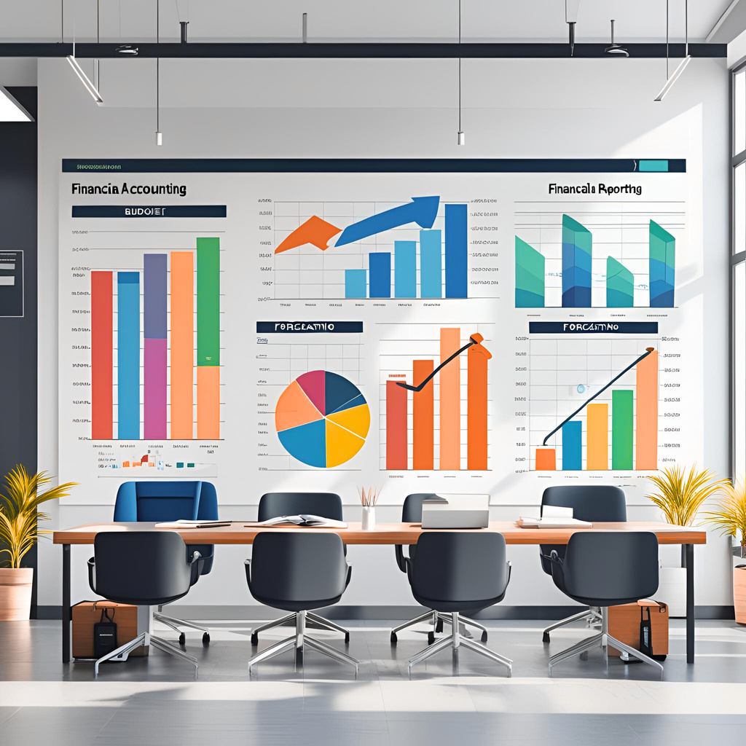
Accounting - the language of business
Accounting - the language of business

Slide 3
Agenda
Agenda
  Course introduction:
    Purpose of the course
    Structure, logistics and performance measurements
  Financial accounting overview:
    Users of the financial information
    The main financial statements
    Regulation
    How to find the financial accounting data
    Market prices and accounting data

Slide 4
Course Overview
Course Overview

Slide 5
What is Financial Accounting?
What is Financial Accounting?
Business storytelling with numbers
  Formally: preparing and sharing financial reports that reflect a company's performance.
This information is useful for:
  Management team and employees
  Business and financial partners
  Investors and analysts
  Regulators

Slide 6

Course Objectives
Course Objectives
Make wise decisions
Analyze and question the data
Read and understand the data
Collect accounting data
Learn rules, principles, guidelines

Slide 7
How to succeed in this class
How to succeed in this class
  Prepare for class like you mean it.
  Engage actively and participate fully.
  Review the material and ask follow-up questions.
  Apply the lessons in real-world scenarios.

Slide 8
Assignments
Assignments
  Quizzes and a final exam
    Practice quizzes and practice exams
  Homework
  Team presentations
  Participation in class and remotely
  Other
    In-class activities
    Review the statements of companies of interest
    Follow the news

Slide 9
Other topics of interest
Other topics of interest
  bCourses website
    Materials
    Assignments
  Textbook
  Office hours, discussion sections, tutoring
  Other communication
  Excel, calculators, AI tools

Slide 10
Financial Accounting Introduction
Financial Accounting Introduction

Slide 11


Accounting system
Accounting system
Accounting System
Financial Accounting Reports
Periodic financial statements and related disclosures
External Decision Makers
Evaluate the company
Managerial Accounting Reports
Detailed plans and continuous performance reports
Internal Decision Makers
Run the company
Creditors
Investors
Managers
Source: Financial accounting, Libby, Libby and Hodge, 10ᵗʰ edition, McGraw-Hill Education

Slide 12
Parties responsible for the reports
Parties responsible for the reports
Corporate managers:
  The CEO and the CFO
  Accounting staff
Board of Directors
Independent Auditors
Regulation

Slide 13
Important notes about Accounting
Important notes about Accounting
Accounting summarizes business data to inform managers and investors about performance and financial position.
Accounting is not a precise science.
Accounting is conservative.
Key principles: accrual, matching, conservatism, full disclosure, materiality.

Slide 14
Financial statements – overview
Financial statements – overview
Period activities – operating, investing and financing
Periodic
Income Statement
Beginning Balance
Sheet
Ending Balance
Sheet
Periodic
Cash Flow
Statement

Slide 15
Key accounting data
Key accounting data
Annual report (form 10K) – most important sections:
  Description of the business and risk factors
  Management discussion and analysis (MD&A)
  Consolidated Financial statements and Notes
Other: Press releases, earnings announcements and guidance
How to obtain the data:
  Corporate websites / investor relations
  SEC website: www.sec.gov

Slide 16
Communication and timing
Communication and timing
Annual and quarterly reports
Earnings announcements and earnings guidance
Important product and personnel news
All material information must reach the public at the same time. Insiders may not trade on material, non-public information.

Slide 17
Summary
Summary

Slide 18
NEED to know from this class
NEED to know from this class
    The purpose of the three main financial statements and what information is provided on these statements
    Who is responsible for the accuracy of the financial statements
    How to find filings and disclosures on the SEC website (sec.gov)
    The structure of the accounting reports
    How to find data about the current market share prices

